Slide 1


Supplie360- an incentivized climate friendly network

Slide 2
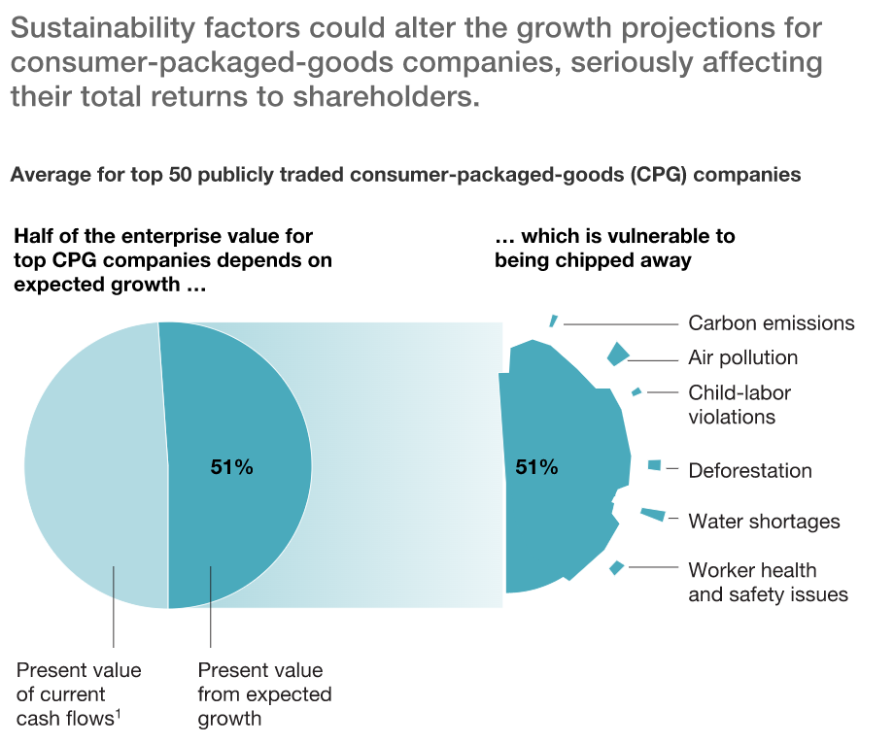
Problem Statement
As per McKinsey, 50% of the revenue of the Supply Chain is being impacted because of the non-optimal processes with the Suppliers and the supply chain network
The need of the hour is to build and establish a mechanism to the Suppliers based on the Climate friendly metrices they adhere to like:
Greenhouse gas emission
Water use
Energy consumption and reduction
Waste production and recycling rate
Usage of plastic
Carbon offsetting

Slide 3
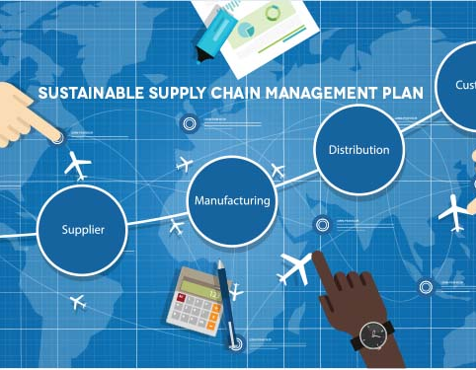
The solution
An optimal solution is to ‘extend’ the existing supply chain solutions to include climate metrics and drive incentivization and discipline mechanism based on the various metrics
We will leverage a full set of Rapyd API in developing a high-quality solution and building the Web solution which will calculate the rewards and ‘disburse’ with Rapyd gateway and also ‘collect’ the disciplined amount – all over a escrow wallet.

Slide 4
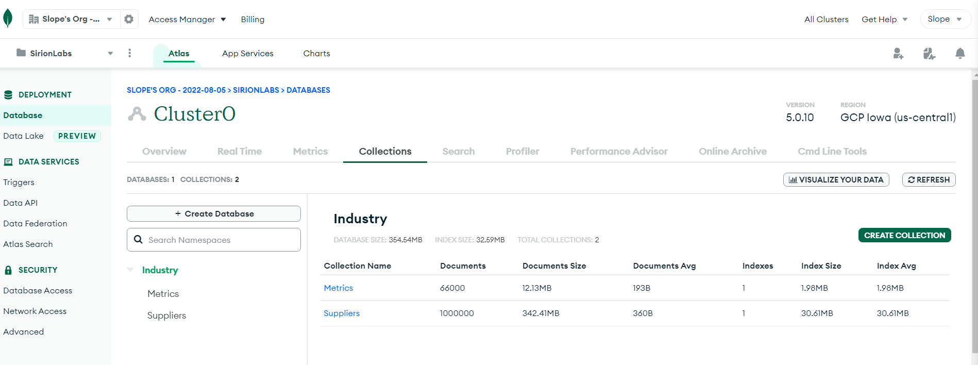
The Data
We are loading 1 Million Suppliers in eight major supply chain industries with various performance parameters like plastic usage, water usage, carbon offsetting, waste disposal and recycling etc. over 5 years

Slide 5

How our solution looks like

Slide 6



solution
Existing Supplier Portal
Manage Suppliers
Manage Supplier Metrics
Search Suppliers
Rank Suppliers
Manage Supplier Payments
Collect Supplier Climate Metrics
Greenhouse gas emission
Water use
Energy consumption and reduction
Waste production and recycling rate
Usage of plastic
Carbon offsetting
Create ‘Climate’ Rapyd Wallets for all suppliers
Climate/Sustainability
Incentives
Pay Incentives and collect penalties

Slide 7
Thank You

